Slide 1
Evidence for Nearby Supernovae in Radioactive ⁶⁰Fe Deposits
Sam Nelson
Physics 205 - Stellar Astronomy
samnelson@u.boisestate.edu

Slide 2
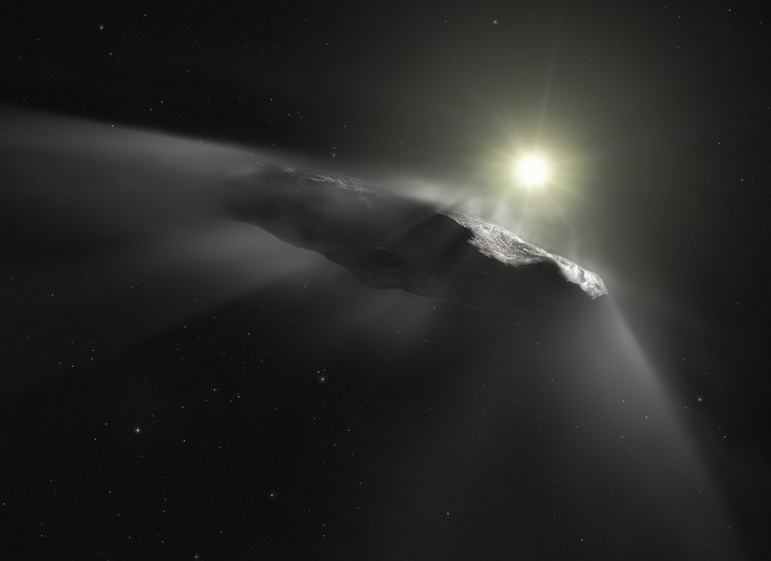
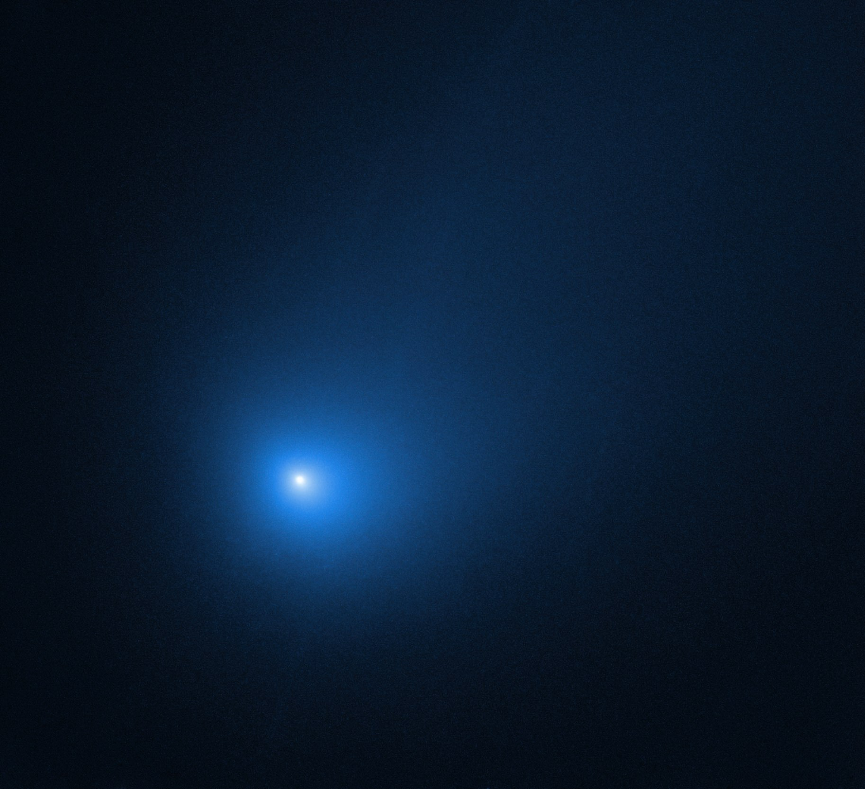
Every day, an estimated 5x10⁴ kg (~60 tons) of cosmic dust rain down on the earth’s surface. Where does it all come from? What is it made of?
Today we’ll take a deeper look at one of the sources of cosmic dust and the story that this dust tells us about the history of our part of the galaxy.
Recently astronomers visually observed for the first time in human history, interstellar objects passing through the solar system, ʻOumuamua (2017) and comet 2I/Borisov (2019). We now have evidence of larger objects entering the solar system, but what about smaller objects, the size of dust grains?
Artist's impression of 1I/2017 U1 - ‘Oumuamua
Comet 2l/Borisov
Notes:
Estimate from (16)
Direct physical evidence is difficult to obtain in Astronomy, so finding material which originated outside our solar system could tell us a great deal about our galaxy and its evolution.
What about smaller objects that are much harder to see, the size of dust grains?

Slide 3
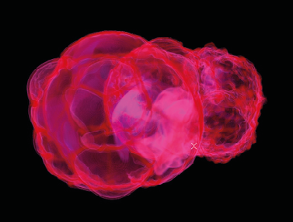
Nearby and recent supernovae have been suspected for some time but concrete evidence was lacking.
Theories have even put forward proposing that nearby supernovae could have caused some of the extinction events we see in the geological record.
Studies of the nearby ISM have shown that the Local Bubble (a low density high temperature region of space surrounding the Solar System) was likely formed from several supernovae of the last few million years.
Notes:
Image is a from a simulation of the Local Bubble growth “Supernovae and the Local Bubble” by Michael M. Schulreich & Dieter Breitschwerdt

Slide 4
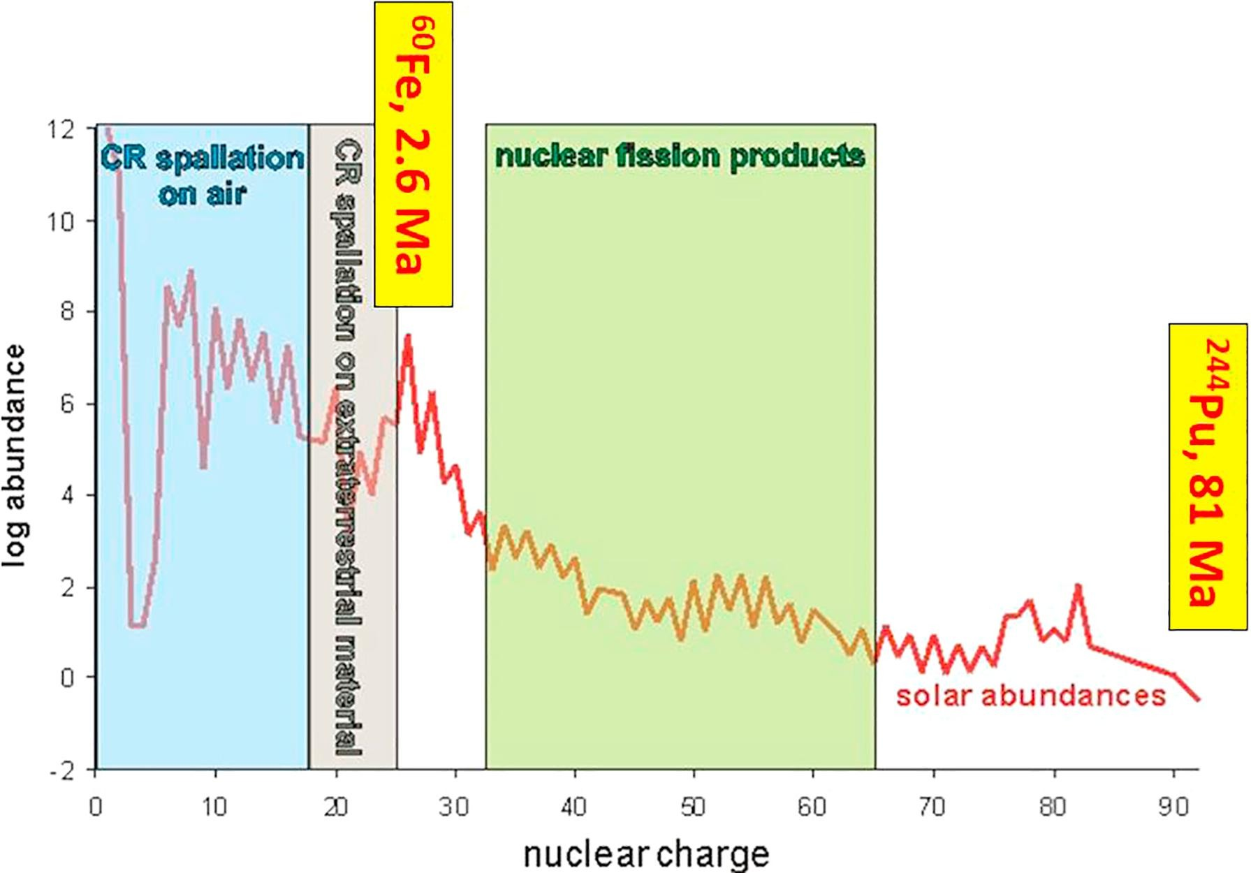
What elements would make good candidates for study to try to find traces of these supernovae today?
Radioactive isotopes allow for potential dating of their nucleosynthesis.
Half-life long enough to capture a historical supernova signal. But not so long as to be indistinguishable from material existing since the birth of the solar system.
Notes:
Fig. 1. Solar abundances of the elements, relative to Si (*106) in a logarithmic scale. Ranges are shown where cosmic ray (CR) produced and fission background can be expected on Earth. For CR-production the abundances of the target elements are relevant. The Fe and Ni isotopes are only partly synthesized in CC-SNe. About 2/3 are produced in SNe IA, i.e. exploding white dwarfs. For fission background only the green range is of relevance. From (17)

Slide 5
Why Fe60?
Produced in large quantities in massive star supernovae. On the order of 3x10⁻⁵ M☉ (Sun) or about 10 M⊕ (Earth)
T_{1/2} 2.6 Myr
Negligible production of ⁶⁰Fe from nuclear tests in the 20th century. (9)

Slide 6
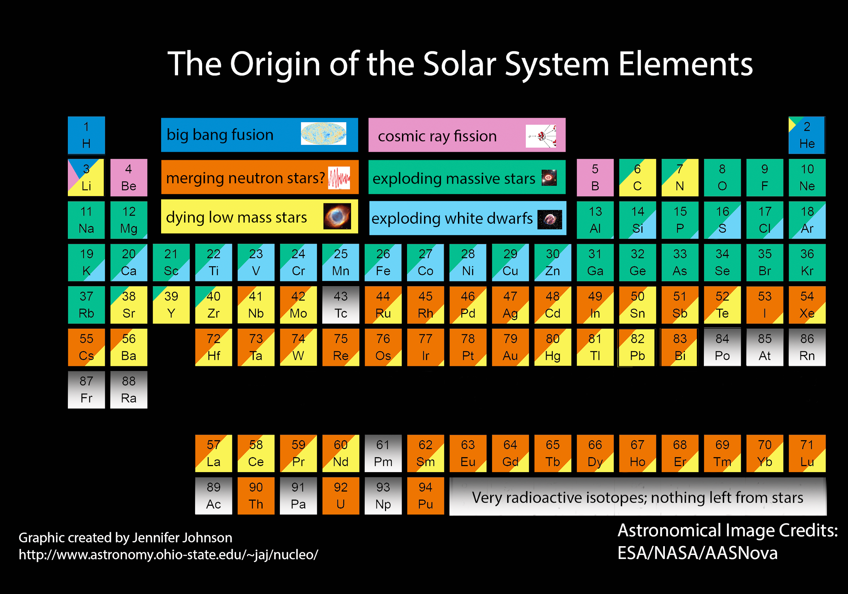
Notes:
Shows the general types of processes that are responsible for nucleosynthesis. Note that cosmic ray fission or spallation is not a significant source of Iron. Note the difference between, type Ia (white dwarf - light blue) and massive star supernovae (green). Especially interesting considering an estimated ratio of type Ia to type II supernovae in the solar neighborhood of about 0.184. Type II are far more frequent than Ia, at least near to the Sun, but type Ia makes the bulk of the iron found!
See http://adsabs.harvard.edu/full/1995MNRAS.277..945T
Fascinating discussion on element origins here:
http://blog.sdss.org/2017/01/09/origin-of-the-elements-in-the-solar-system/

Slide 7
Eliminating other sources
Cosmic ray interactions with Kr in the Earth’s atmosphere.
Neutron capture by ⁵⁸Fe and ⁵⁹Fe
Neutron capture can be minimized as a source (20) since ⁵⁹Fe is not stable (T_{1/2} = 44.5 days) and ⁵⁸Fe, while stable has a very low natural abundance of 0.28%.
Spallation of Kr in the Earth’s atmosphere was calculated (20) to produce/deposit ⁶⁰Fe at a rate at least two orders of magnitude lower than the calculated interstellar flux of ⁶⁰Fe.
Notes:
See reference (19) for a deep discussion on cosmic ray generated Fe60

Slide 8
Eliminating other sources (Continued)
Meteorites and interplanetary dust containing ⁶⁰Fe falling to the Earth’s surface. ⁶⁰Fe created from Cosmic ray spallation/fission of ⁶²Ni and ⁶⁴Ni.
Compared to the previous potential sources, local solar system material exposed to Cosmic rays is a significant source of ⁶⁰Fe and must be accounted for.
In addition to the measurement of ⁶⁰Fe the amount of ⁵³Mn (created by cosmic ray spallation) was measured so that the ratio between them could be compared.
It was calculated (20) that the ratio ⁶⁰Fe/⁵³Mn should be ~5x10⁻⁴ for interplanetary dust. The actual measured value in samples was closer to ~10⁻². This difference must be due to another source of ⁶⁰Fe.
Notes:
See reference (19) for a deep discussion on cosmic ray generated Fe60

Slide 9
Evidence of supernovae produced ⁶⁰Fe has been found in:
Deep sea sediment and manganese crusts (1)
Lunar soil (Apollo sample returns) (7)
Deep ocean magnetofossils from magnetotactic bacteria (8)
Recent Antarctic snowpack (9)
⁶⁰Fe Nuclei detected as Cosmic Rays by NASA's Advanced Composition Explorer (18)
Notes:
Meteoritic Fe60 also does not come from a primordial source due to the relatively short half-life. It is formed from cosmic rays interacting with the materials in the meteorite. Meteorite size determines how this interaction takes place (19)

Slide 10
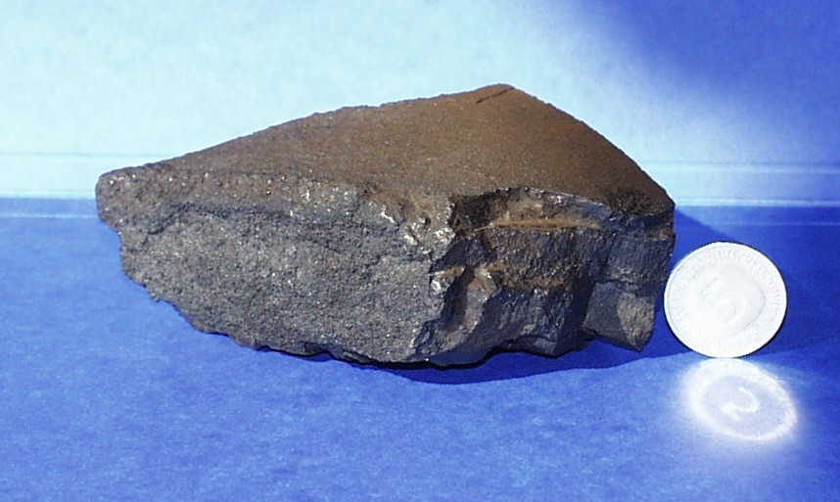
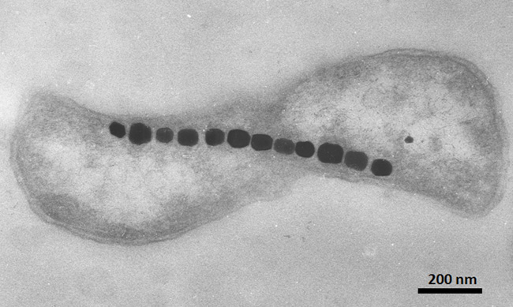
Magnetotactic bacteria
Ferromanganese crust recovered from the Pacific ocean floor.
Notes:
From: https://webarchiv.typo3.tum.de/PH/gams/en/research/scientific-highlights/supernova-produced-fe-60-on-earth/index.html
Also: https://www.newscientist.com/article/mg16321940-300-hot-iron-cold-sea/
And: https://www.nature.com/scitable/knowledge/library/bacteria-that-synthesize-nano-sized-compasses-to-15669190/

Slide 11
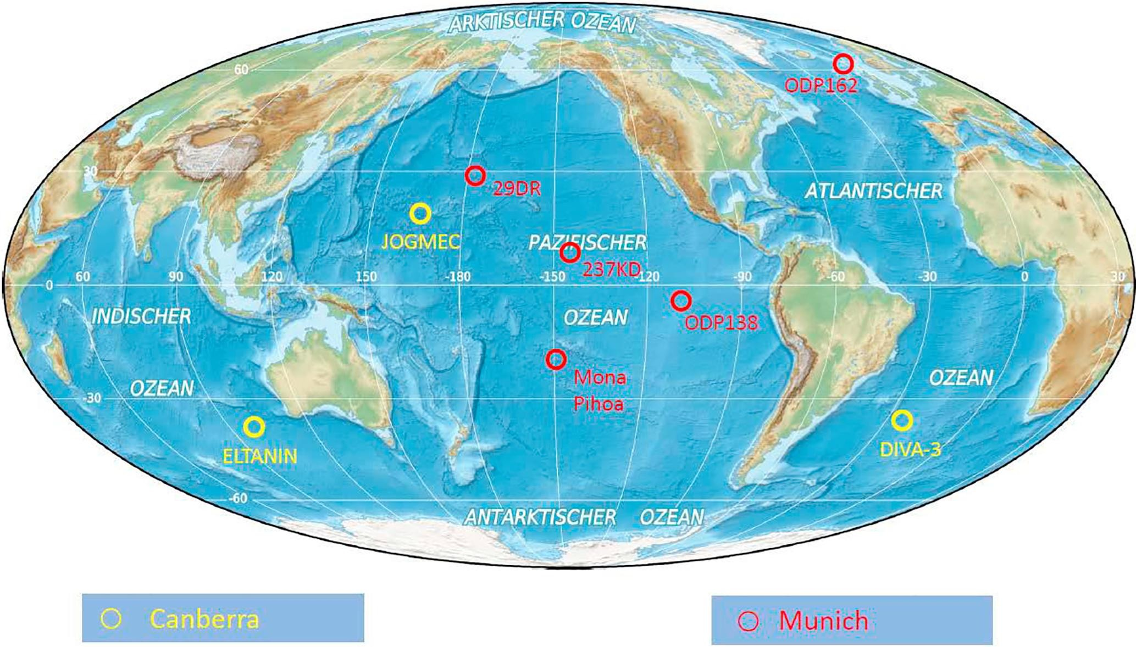
Notes:
From (17)
Some of the different sites that scientists have gathered sediment and manganese crust samples for study.
AMS facilities capable of analyzing samples containing the small trace amounts of Fe60 the scientists are looking for are only available in Canberra AU and Munich DE.
Fig. 6. Positions where deep-ocean samples have been obtained and analyzed with respect to their 60Fe concentration in Munich (red) and Canberra (yellow). Map taken from https://de.wikipedia.org/wiki/Datei:World_oceans_map_mollweide_de.png. (For interpretation of the references to colour in this figure legend, the reader is referred to the web version of this article.)

Slide 12
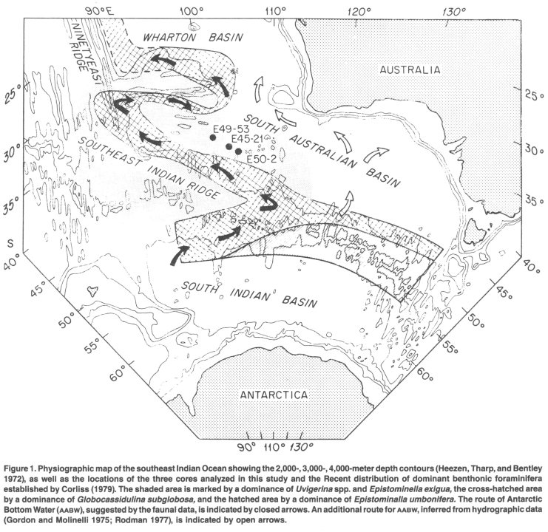
“Eltanin” Core sample locations from three cruises E45, E49 and E50.
Locations on the sea floor where iron bearing sediments were retrieved by core drilling in the late 1960’s and early 1970’s.
Samples were analyzed for ⁶⁰Fe content nearly 40 years after collection!

Slide 13
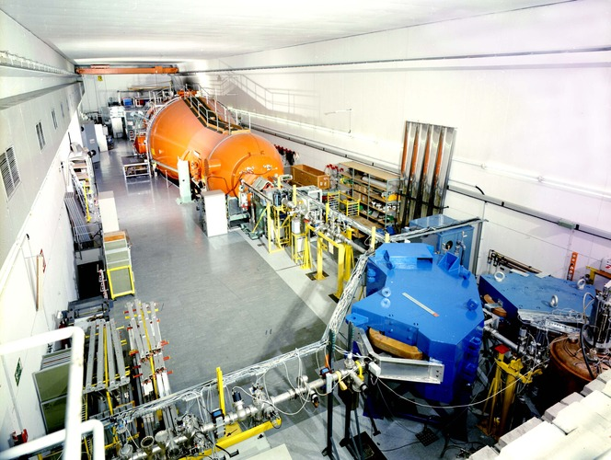
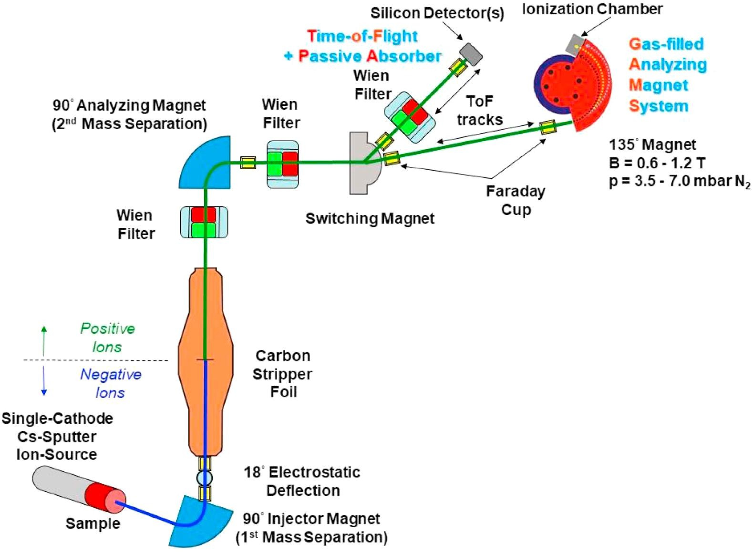
Munich AMS components
TUM Munich Accelerator mass spectrometry (AMS) machine
Notes:
AMS is very useful for separating rare isotopes from other isotopes of the same element. This is why it was chosen to analyze the infinitesimal concentration of Fe60 from the surrounding (and not rare) Fe isotopes in the sample like Fe56.
From: https://www.mll-muenchen.de/tandem/index.html
From: https://ars.els-cdn.com/content/image/1-s2.0-S0168583X18303501-gr2_lrg.jpg (17)

Slide 14
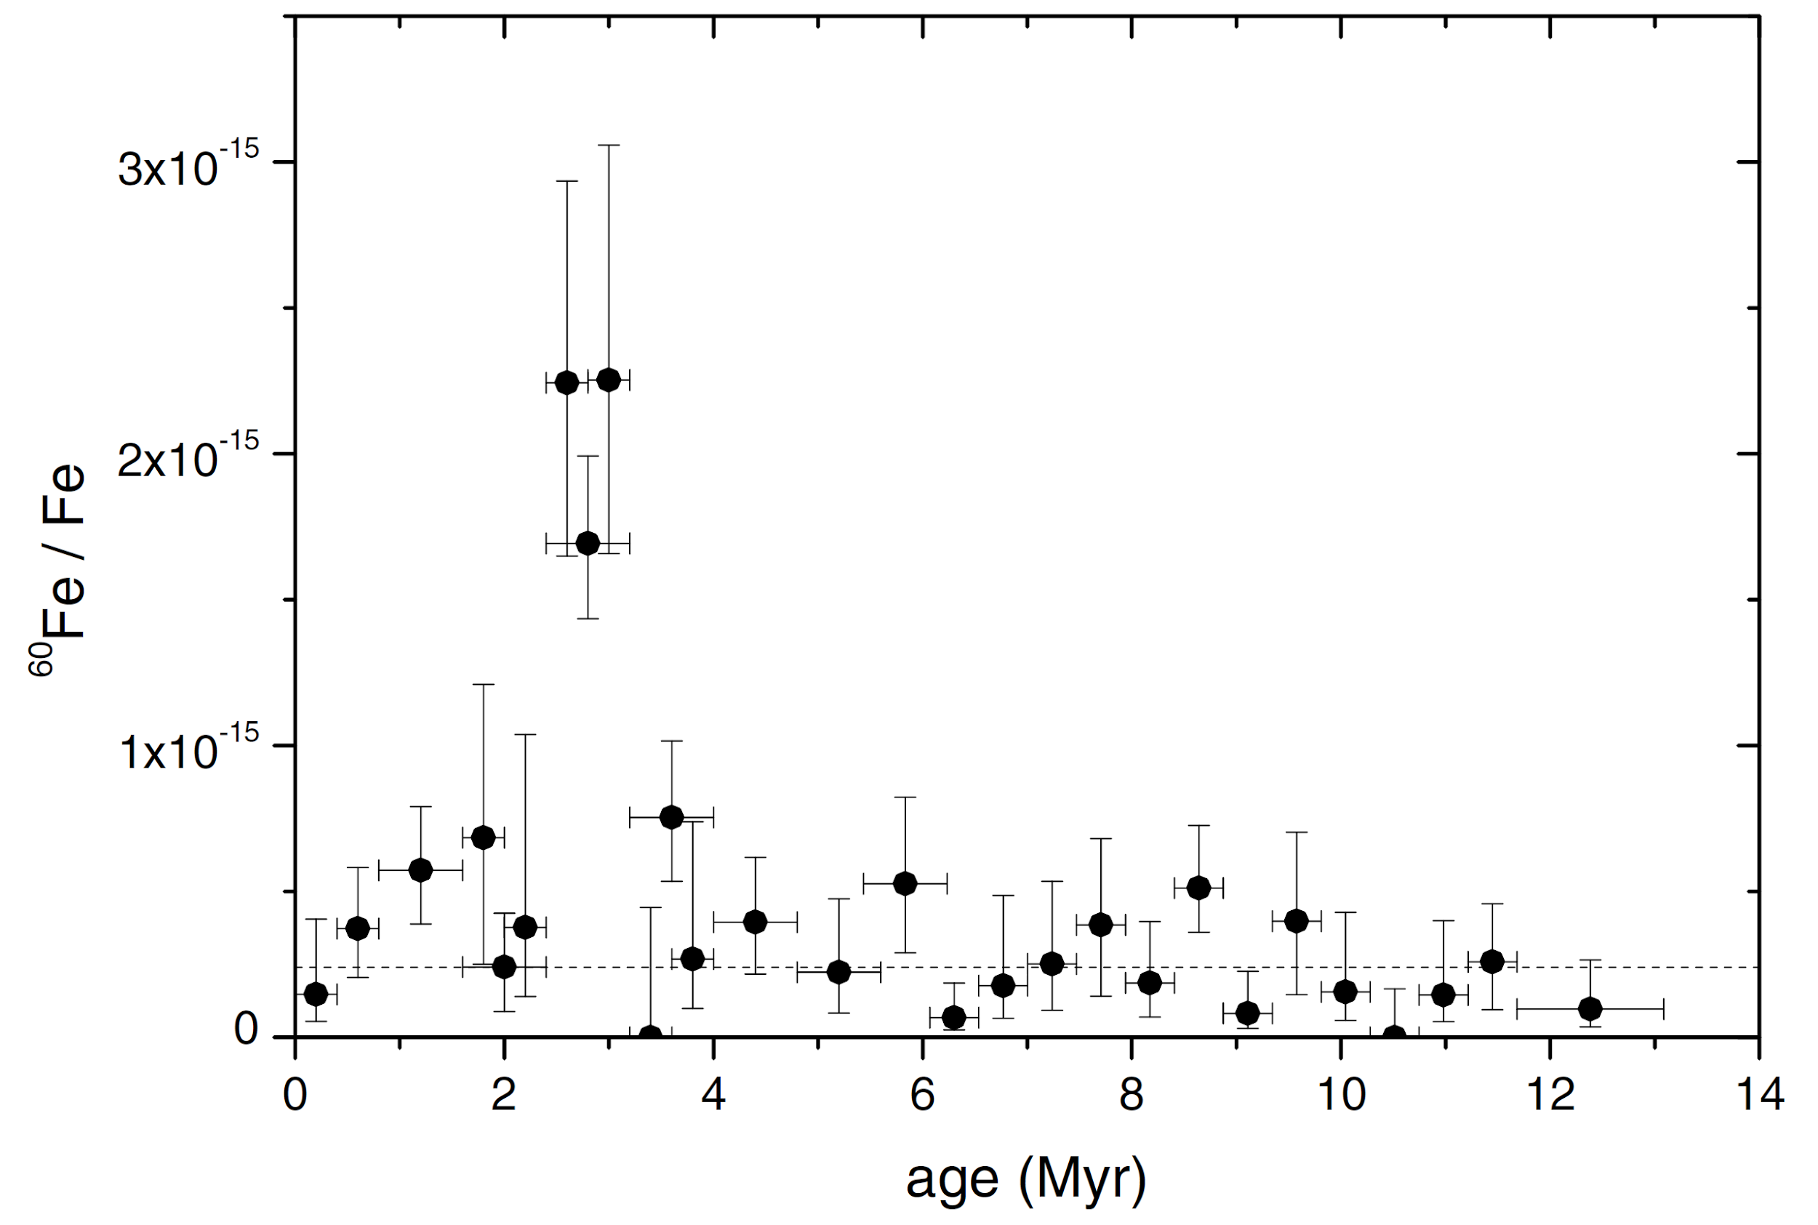
2004 Knie et al
Notes:
FIG. 1. 60Fe=Fe ratios versus the age of the layer. The data are
not corrected for radioactive decay, background, and uptake of
iron into the crust. The vertical error bars correspond to a
confidence level of 68.3%; the horizontal error bars indicate the
time interval covered by the layer. The background level of
2.4x10^-16 is indicated by the dashed line.

Slide 15
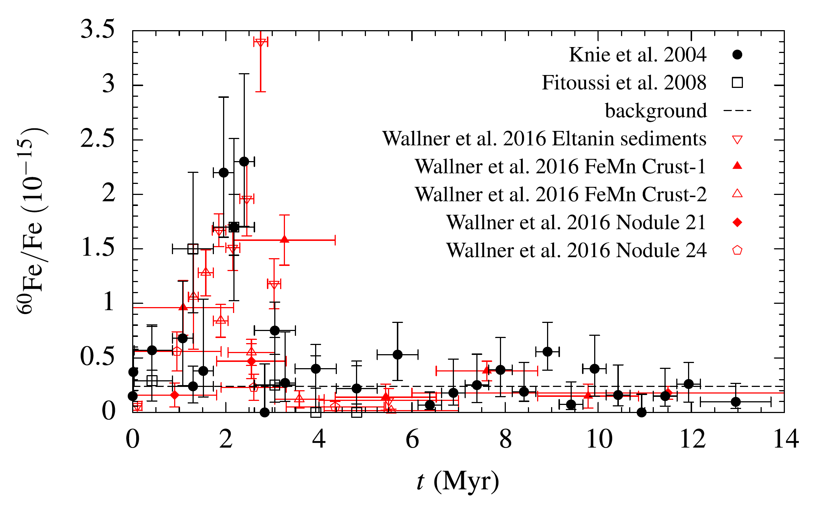
Notes:
From: “Supernovae and the Local Bubble” by Michael M. Schulreich & Dieter Breitschwerdt

Slide 16
There are some clues which point to a nearby OB associations as the source of ⁶⁰Fe
(18) indicates that the supernovae which create ⁶⁰Fe are not necessarily the same supernovae which propel it to high velocity.
This would require multiple supernovae in succession to create ⁶⁰Fe and then transport it towards Earth.
The supernovae would need to be close enough to earth for the ⁶⁰Fe to travel the distance before decaying completely (half-life 2.6 Myr).

Slide 17
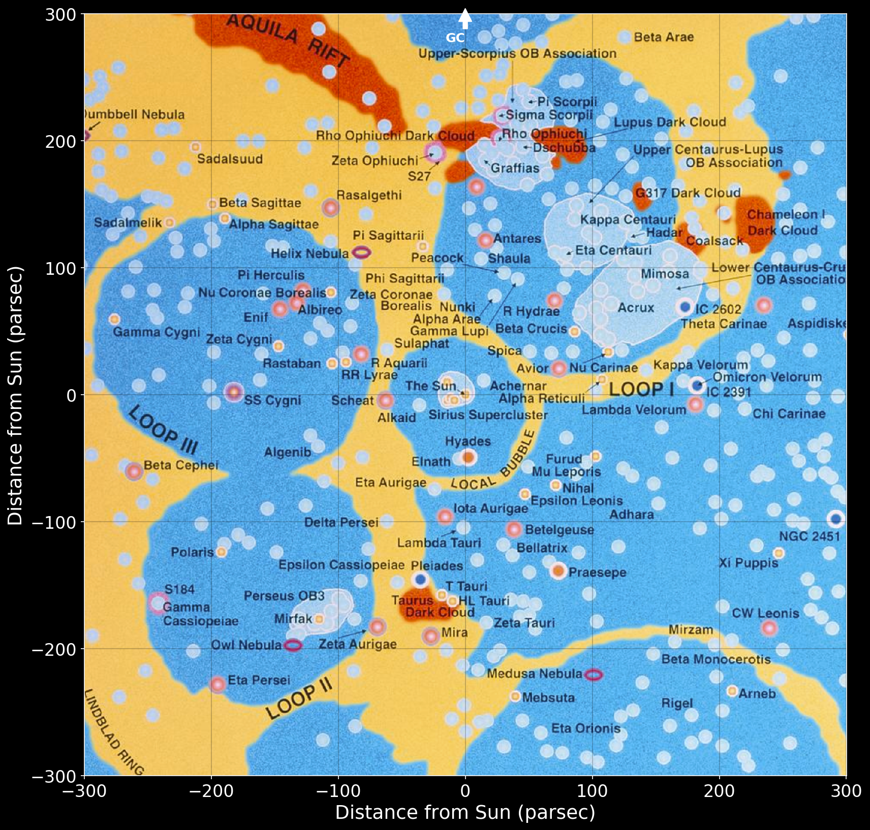
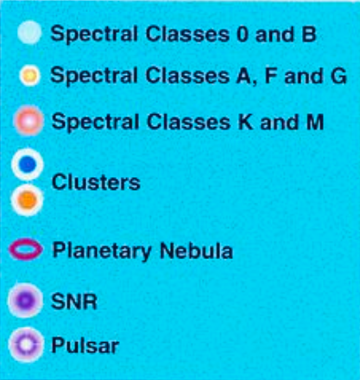
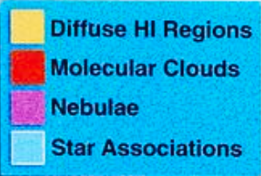
The solar system’s proximity to the Upper Centaurus Lupus (UCL) and Lower Centaurus Crux (LCC) OB associations.
Yellow: dense (1 cm⁻³), warm (5000K) gas
Blue: low density (0.001-0.01cm⁻³), hot (10⁵ - 10⁶ K)
Notes:
Looking down on the sun and its neighbors from galactic north. The center of the galaxy is straight up.
Adapted from The Guide to the Galaxy and Knie presentation “SN produced Radioactivity on Earth”

Slide 18
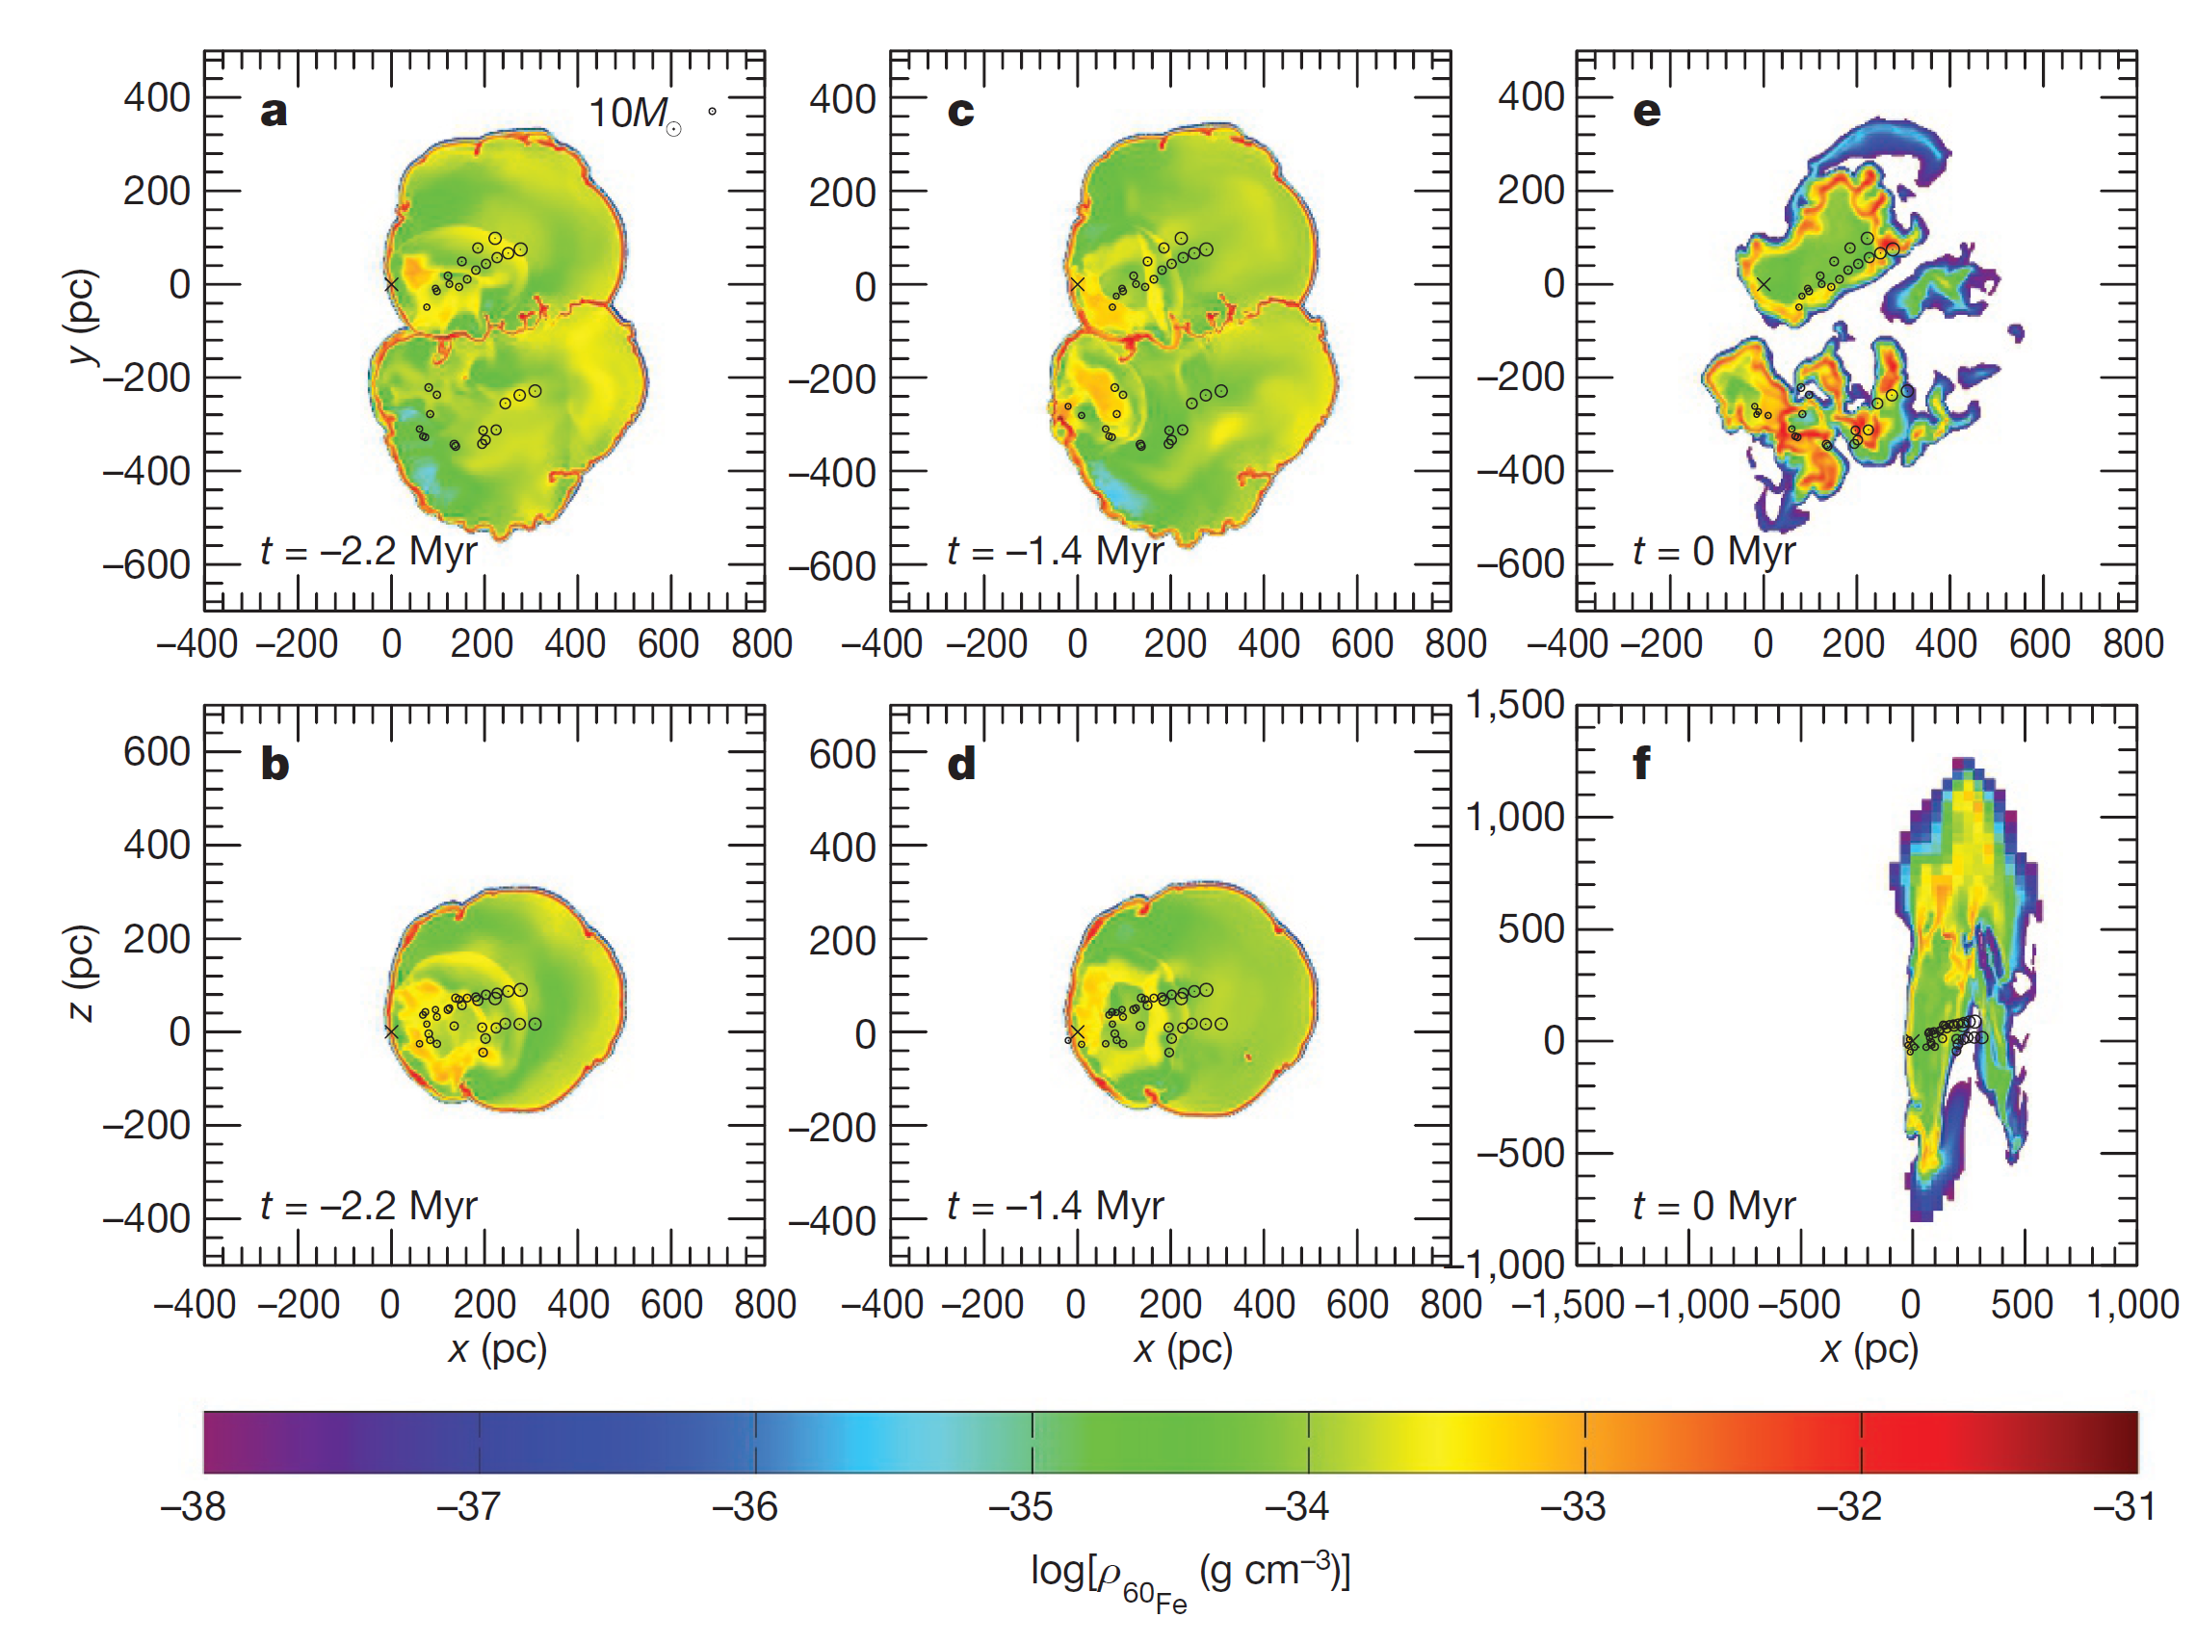
Notes:
From (22) Figure 3 | Numerical simulations for
60Fe distribution associated with the
Local and Loop I superbubbles.
a–d, The 60Fe mass density distribution,
ρ60Fe, for the bubbles expanding into a
homogeneous ambient medium with a
number density of n0 = 0.3 cm−3 at t = 2.2
and 1.4 Myr before present. e, f, The same
setup for an inhomogeneous background
medium at t = 0. The supernova explosion
centres are indicated by dotted circles
(sizes corresponding to stellar masses),
colour coding refers to logarithmic mass
density of 60Fe, and the cross to the
location of the Solar System. The bubble
interaction and reflected shocks are
visible as reddish filaments.

Slide 19
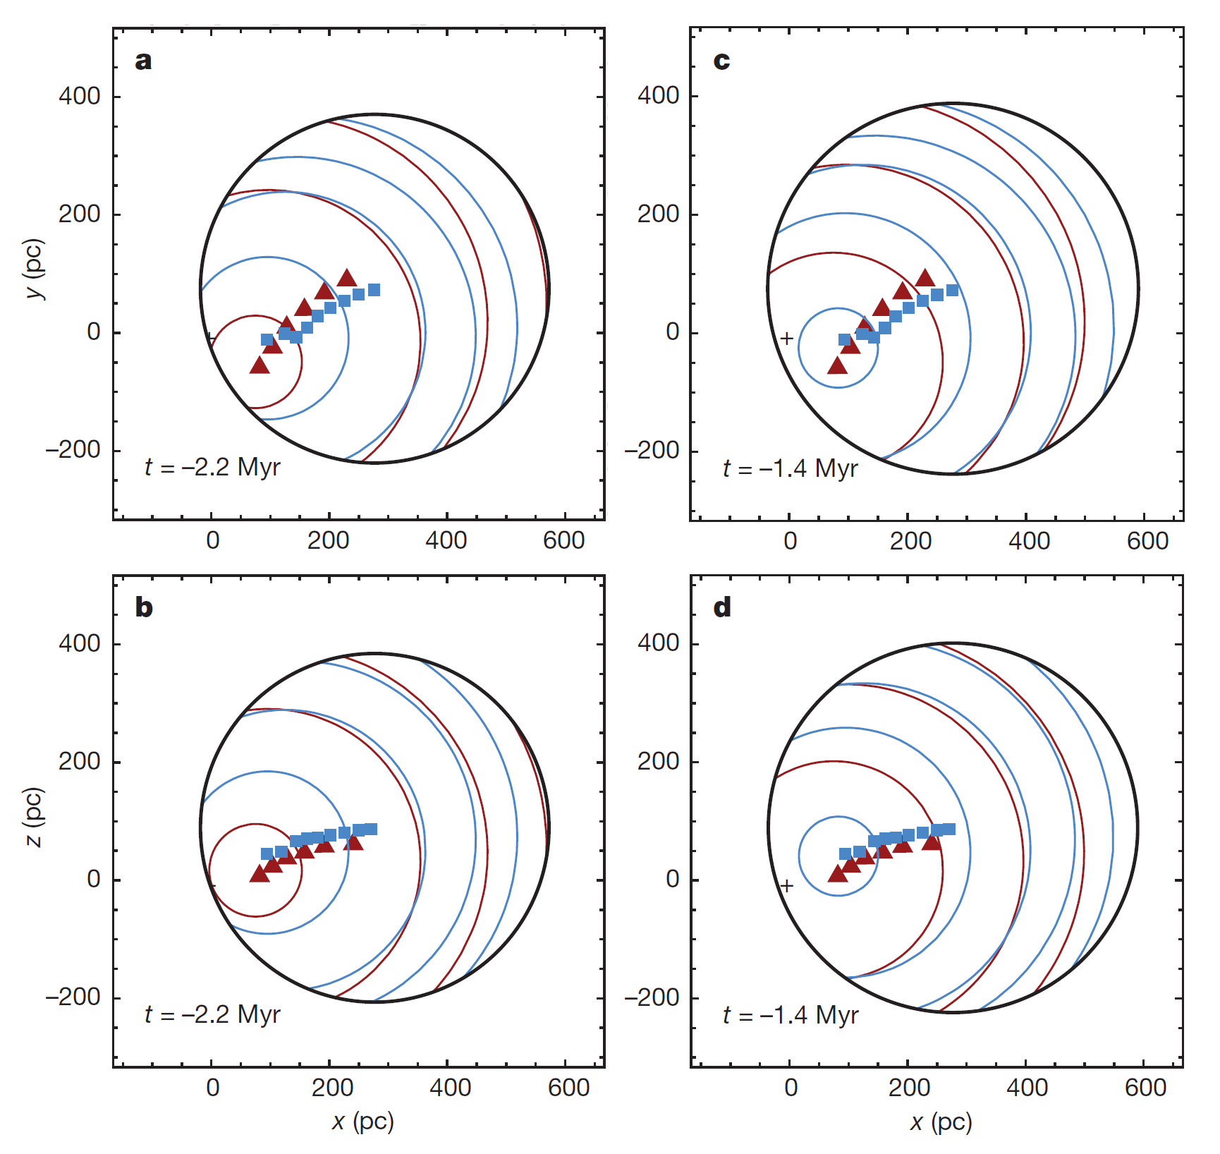
Modeled supernovae in the Local Bubble at two points in time. Outer black circle represents the pre-existing Local Bubble boundary. Red and blue circles correspond to the explosions of the modeled supernovae.
Notes:
From (22) Figure 2 | Analytical model of 60Fe-carrying
shells at 1.4 Myr and 2.2 Myr before present.
The outer black shell results from the Local Bubble
evolution21,22. The inner shells correspond to
single remnants of stellar explosions (companion
stars are now in UCL (blue) and LCC (red)), taking
about 0.1 Myr to reach Earth. The blue squares
and red triangles show the explosion sites of the
UCL and LCC stars, respectively; the black cross
denotes the position of the Sun. The layout of the
panels corresponds to Fig. 1.

Slide 20
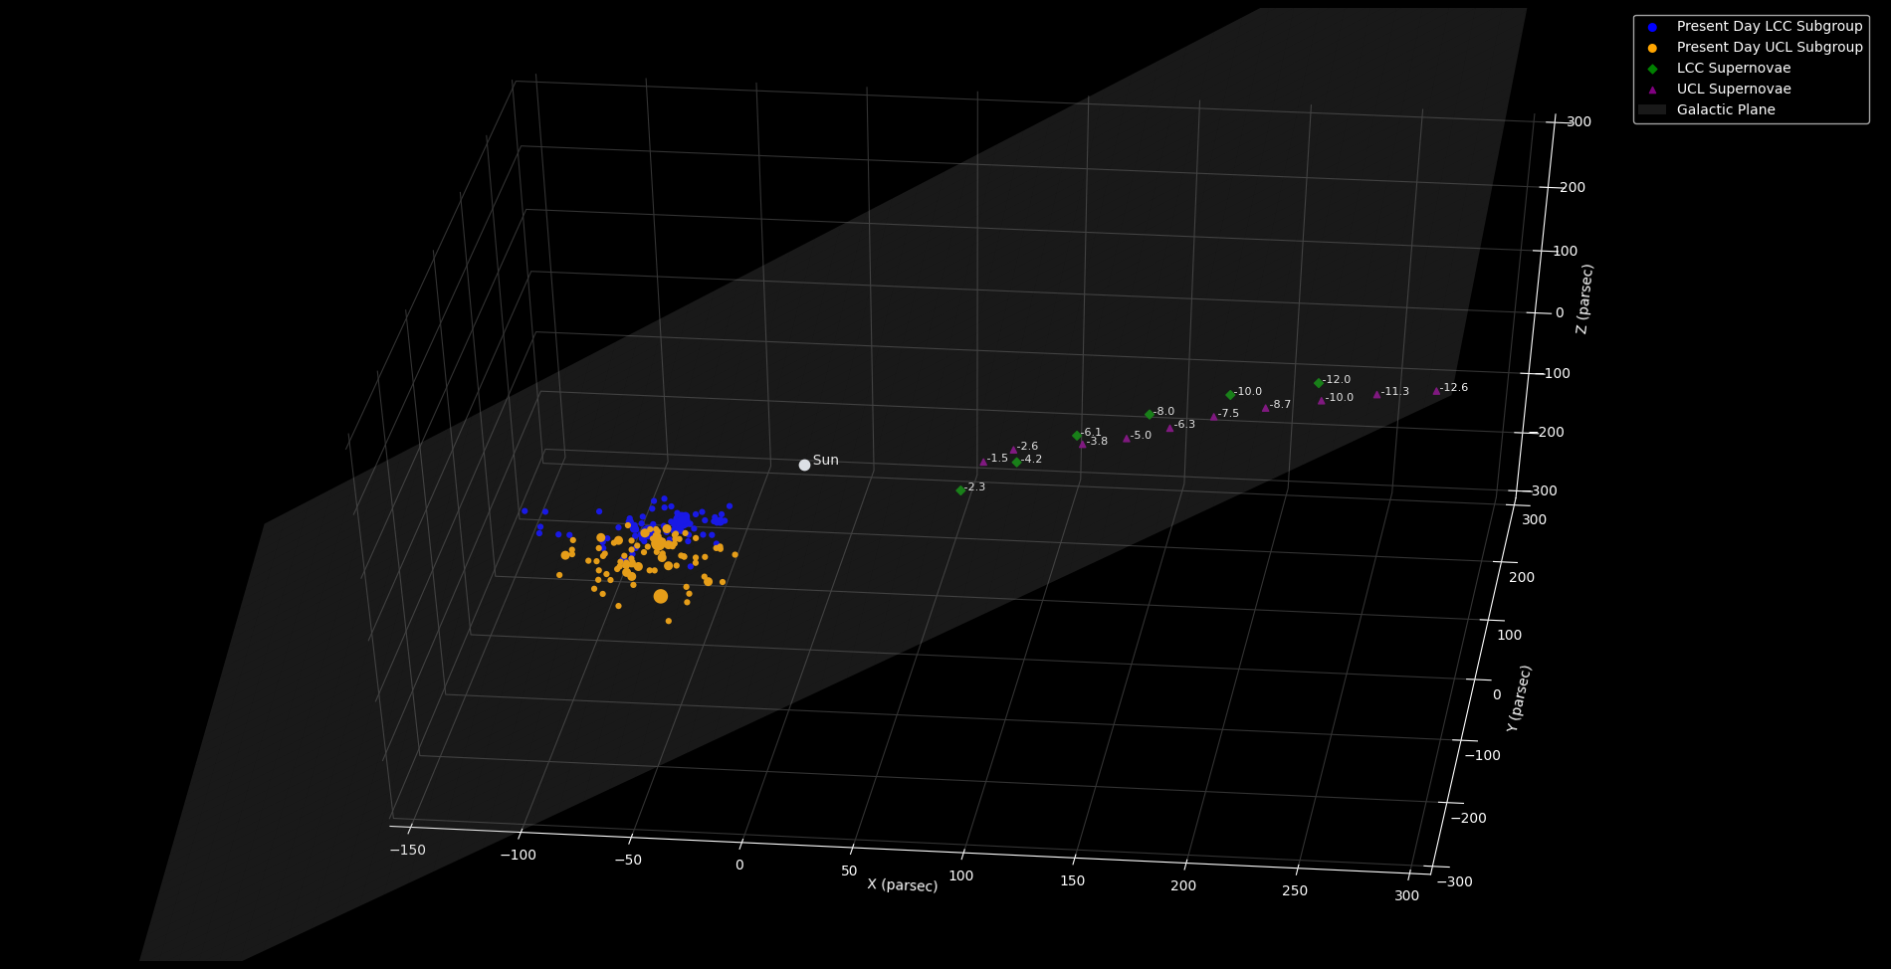
X
OOPS!!
Notes:
This was originally going to try to show in a 3D format the relative orientations and movement of the UCL, LCC and the modeled supernovae. I realized at the last minute that I had misunderstood the galactic coordinate system and the results were misleading and definitely wrong! I thought I would just leave this in here so my mistake might help someone else out, always be suspicious of your results I guess is the takeaway!
UCL and LCC Data from SIMBAD, (15) and modeled supernovae locations/ages from (22). Graphic created using Astroquery and Astropy Python modules.
Modeled supernovae locations are at points as they would have occurred at time indicated (in Myr). You can see a clear trend as the relative motion of the OB association carried it near the solar system.

Slide 21
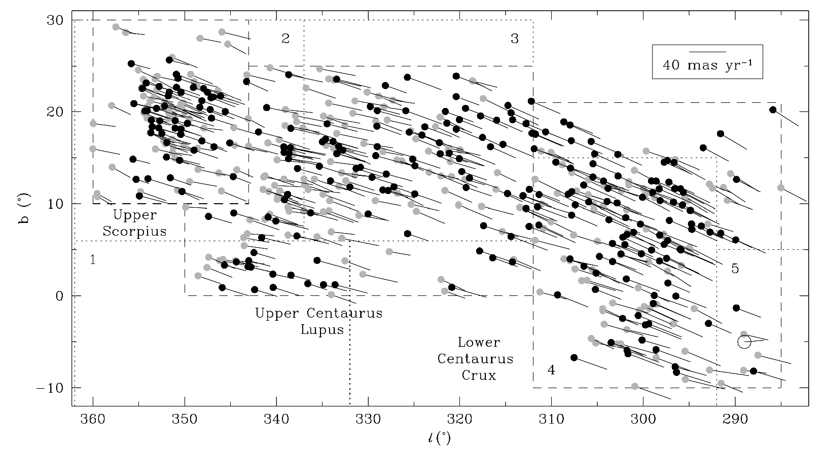
Notes:
Figure 2. Map of the Sco-Cen region, showing the positions and proper motions
of the Hipparcos members (adapted from de Zeeuw et al. (1999) and kindly provided
by Tim de Zeeuw). -- From (15)

Slide 22
Conclusions
After analyzing many different sources of material, it is clear that there are physical traces of recent, local supernovae here on Earth.
Modeling has shown some possible supernovae candidates for the ⁶⁰Fe deposits found in various samples that have been analyzed. As better astrometric data is made available (for instance from subsequent Gaia data releases) it should be possible to fine-tune the models to more accurately determine parameters for these nearby supernovae.
This information allows us to better understand how our local galactic neighborhood has changed over the last few million years and the impact these changes have had on the solar system and Earth.
Sam Nelson
Physics 205 - Stellar Astronomy
samnelson@u.boisestate.edu

Slide 23
References
[1] Feige, J., Wallner, A., Winkler, S. R., Merchel, S., Fifield, L. K., Korschinek, G., … Breitschwerdt, D. (2012). The Search for Supernova-Produced Radionuclides in Terrestrial Deep-Sea Archives. Publications of the Astronomical Society of Australia, 29(2), 109–114. https://doi.org/10.1071/as11070
[2] Cendes, Y., Gaensler, B. M., Ng, C.-Y., Zanardo, G., Staveley-Smith, L., & Tzioumis, A. K. (2018). The Reacceleration of the Shock Wave in the Radio Remnant of SN 1987A. The Astrophysical Journal, 867(1), 65. https://doi.org/10.3847/1538-4357/aae261
[3] Allison, E., & Ledbetter, M. T. (1982). Timing of bottom-water scour recorded by sedimentological parameters in the South Australian Basin. Marine Geology, 46(1–2), 131–147. https://doi.org/10.1016/0025-3227(82)90155-4
[4] Kachelrieß, M., Neronov, A., & Semikoz, D. V. (2018). Cosmic ray signatures of a 2–3 Myr old local supernova. Physical Review D, 97(6). https://doi.org/10.1103/physrevd.97.063011
[5] Henbest, N., & Couper, H. (1994). The guide to the galaxy. Cambridge England: Cambridge University Press.
[6] Curators Of Marine And Lacustrine Geological Samples Consortium. (n.d.). Index to Marine and Lacustrine Geological Samples (IMLGS) [Data set]. NOAA National Centers for Environmental Information. https://doi.org/10.7289/V5H41PB8
[7] Fimiani, L., Cook, D. L., Faestermann, T., Gómez-Guzmán, J. M., Hain, K., Herzog, G., … Rugel, G. (2016). Interstellar ⁶⁰Fe on the Surface of the Moon. Physical Review Letters, 116(15). https://doi.org/10.1103/physrevlett.116.151104
[8] Ludwig, P., Bishop, S., Egli, R., Chernenko, V., Deneva, B., Faestermann, T., Famulok, N., Fimiani, L., Gómez-Guzmán, J. M., Hain, K., Korschinek, G., Hanzlik, M., Merchel, S., & Rugel, G. (2016). Time-resolved 2-million-year-old supernova activity discovered in Earth’s microfossil record. Proceedings of the National Academy of Sciences, 113(33), 9232–9237. https://doi.org/10.1073/pnas.1601040113
[9] Koll, D., Korschinek, G., Faestermann, T., Gómez-Guzmán, J. M., Kipfstuhl, S., Merchel, S., & Welch, J. M. (2019). Interstellar Fe60 in Antarctica. Physical Review Letters, 123(7). https://doi.org/10.1103/physrevlett.123.072701
[10] Gall, C., Hjorth, J., Watson, D., Dwek, E., Maund, J. R., Fox, O., Leloudas, G., Malesani, D., & Day-Jones, A. C. (2014). Rapid formation of large dust grains in the luminous supernova 2010jl. Nature, 511(7509), 326–329. https://doi.org/10.1038/nature13558
[11] Fitoussi, C., Raisbeck, G. M., Knie, K., Korschinek, G., Faestermann, T., Goriely, S., Lunney, D., Poutivtsev, M., Rugel, G., Waelbroeck, C., & Wallner, A. (2008). Search for Supernova-Produced Fe60 in a Marine Sediment. Physical Review Letters, 101(12). https://doi.org/10.1103/physrevlett.101.121101
[12] Landgraf, M. (2000). Modeling the motion and distribution of interstellar dust inside the heliosphere. Journal of Geophysical Research: Space Physics, 105(A5), 10303–10316. https://doi.org/10.1029/1999ja900243
[13] Hirshfeld, A. (2013). Parallax : the race to measure the cosmos. Mineola, N.Y: Dover Publications.
[14] Robitaille, T. P., Tollerud, E. J., Greenfield, P., Droettboom, M., Bray, E., Aldcroft, T., Davis, M., Ginsburg, A., Price-Whelan, A. M., Kerzendorf, W. E., Conley, A., Crighton, N., Barbary, K., Muna, D., Ferguson, H., Grollier, F., Parikh, M. M., Nair, P. H., … Streicher, O. (2013). Astropy: A community Python package for astronomy. Astronomy & Astrophysics, 558, A33. https://doi.org/10.1051/0004-6361/201322068
[15] Reipurth, B. (2008). Handbook of star forming regions. San Francisco: Astronomical Society of the Pacific
[16] Gardner, C. S., Liu, A. Z., Marsh, D. R., Feng, W., & Plane, J. M. C. (2014). Inferring the global cosmic dust influx to the Earth’s atmosphere from lidar observations of the vertical flux of mesospheric Na. Journal of Geophysical Research: Space Physics, 119(9), 7870–7879. https://doi.org/10.1002/2014ja020383
[17] Korschinek, G., & Faestermann, T. (2019). Long-lived radio-isotopes: Unique signatures of close-by supernovae in the past. Nuclear Instruments and Methods in Physics Research Section B: Beam Interactions with Materials and Atoms, 438, 148–155. https://doi.org/10.1016/j.nimb.2018.05.034
[18] Binns, W. R., Israel, M. H., Christian, E. R., Cummings, A. C., de Nolfo, G. A., Lave, K. A., … Wiedenbeck, M. E. (2016). Observation of the 60Fe nucleosynthesis-clock isotope in galactic cosmic rays. Science, 352(6286), 677–680. https://doi.org/10.1126/science.aad6004
[19] Leya, I., David, J.-C., Faestermann, T., Froehlich, M., Kivel, N., Koll, D., Korschinek, G., McIntyre, S., Merchel, S., Pavetich, S., Rugel, G., Schumann, D., Smith, T., & Wallner, A. (2020). 53 Mn and 60 Fe in iron meteorites-New data, model calculations. Meteoritics & Planetary Science. https://doi.org/10.1111/maps.13466
[20] Knie, K., Korschinek, G., Faestermann, T., Wallner, C., Scholten, J., & Hillebrandt, W. (1999). Indication for Supernova Produced 60Fe Activity on Earth. Physical Review Letters, 83(1), 18–21. https://doi.org/10.1103/physrevlett.83.18
[21] Schulreich, Michael M., Breitschwerdt, Dieter (2016, December) Supernovae and the Local Bubble Workshop on “Sources of Galactic cosmic rays” APC, Paris
Retrieved from http://www.apc.univ-paris7.fr/~semikoz/CosmicRays2016/Dec9/Schulreich_Paris2016.pdf
[22] Breitschwerdt, D., Feige, J., Schulreich, M. M., Avillez, M. A. de., Dettbarn, C., & Fuchs, B. (2016). The locations of recent supernovae near the Sun from modelling 60Fe transport. Nature, 532(7597), 73–76. https://doi.org/10.1038/nature17424

Slide 24
Additional Reference Material

Slide 25

Gaia Sky Software
https://zah.uni-heidelberg.de/institutes/ari/gaia/outreach/gaiasky/downloads/
With the latest release of the Gaia data DR2
https://www.cosmos.esa.int/web/gaia/release
DR3 will likely have even better precision.
It may be possible to extrapolate hypothetical solar neighborhood structure around the timeframe of these supernova debris deposits.

Slide 26
Stellar Associations
Scorpius-Centaurus (Sco OB2)
http://simbad.harvard.edu/simbad/sim-ref?bibcode=2008HSFR2.B....235P&simbo=on
SIMBAD Association “NAME ASSOC II SCO -- Association of Stars”
http://simbad.harvard.edu/simbad/sim-id?Ident=%403456396&Name=NAME%20ASSOC%20II%20SCO&submit=submit
Subgroups
NAME Upper Sco Association -- Association of Stars
http://simbad.u-strasbg.fr/simbad/sim-id?Ident=NAME%20Upper%20Sco
NAME Upper Centaurus Lupus -- Association of Stars
http://simbad.u-strasbg.fr/simbad/sim-id?Ident=NAME%20Upper%20Cen-Lup
NAME Lower Centaurus Crux -- Association of Stars
http://simbad.u-strasbg.fr/simbad/sim-id?Ident=NAME%20Lower%20Cen-Cru

Slide 27
Debris transport to Earth
Ejecta speed (see (2))
Ejecta size (see (10 and 11, 12…))
“Rapid formation of large dust grains in the luminous supernova 2010jl” indicates that larger dust grains can form quickly from supernovae. Larger dust grains would be easier to explain how they were transported into the solar system against the solar wind. Talk about how smaller dust grains are greatly affected by the magnetic fields and charges in the solar system, while larger grains are not as much.

Slide 28
Takeaway Questions
What interesting new developments or refinements will arise from better quality data like the upcoming Gaia DR3 release?
How did these supernova influence the formation of stars in these regions?

Slide 29
Some other candidate elements
From knie powerpoint
Be10: weak indication for enhancement at t = 2.7 Myr
* sediments and crusts (tegether with fe60)
Al26: in-situ production in crusts dominant
* sediment (together with Fe60), but still dificult (because of in-situ production?)
Mn53: no significant signal, but not in contradiction with expectation
* reduce statistical errors, more crusts
Pu244: fits well to Fe60 (within a large error)
* experimental verification needed, large (kg) crust samples, depth profile.

Slide 30
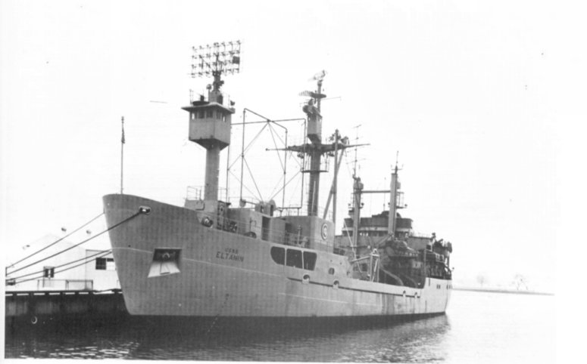
Sediment coring
Name:
USS Eltanin
Namesake:
A star in the constellation Draco
Gamma Draconis is now the more commonly used name for Eltanin. The star itself has an interesting history as it relates to astronomical discovery. James Bradley unsuccessfuly tried to measure the parralax of this star in 1728. He did however discover the abberation of light from the movement of the earth in its orbit around the sun. This and many more interesting stories in the book “Parallax” (13).
The cores now live at OSU!
https://www.registerguard.com/news/20200124/oregon-state-university-to-hold-open-house-at-renovated-expanded-ocean-research-facility
http://osu-mgr.org/
https://arcg.is/HPbT9
e45-21
https://www.ngdc.noaa.gov/geosamples/showsample.jsp?imlgs=imlgs0003321

